Slide 1

Crude Oil Production & GDP Impact on Climate Change
Group Members:
Diana, Simon, Vino & Lee

Slide 2

Project Formulation
What we thought (hypothesis):
GDP and crude oil production correlate with changes in global temperature, causing sea ice mass deterioration.
Questions posed:
Can a direct correlation be identified between oil production and temperature increases?
Do increases in GDP impact climate change?
Is there a correlation between oil production and sea ice melt?

Slide 3
Data Gathering
Data was pulled from the NASA website (temperature data) and Index Mundi website (crude oil production) for correlation analysis between oil production and temperature increases.
Temperature Data: https://data.giss.nasa.gov/gistemp/
Crude Oil Data: https://www.indexmundi.com/energy/?product=oil&graph=production
GDP data was pulled from The World Bank for correlation analysis between GDP and temperature increases.
GDP Data: https://databank.worldbank.org/indicator/NY.GDP.MKTP.KD.ZG/1ff4a498/Popular-Indicators#
To analyze potential correlation between sea ice melt and crude oil production & GDP increases, data was pulled from The EPA website
EPA data:
https://www.epa.gov/climate-indicators/climate-change-indicators-glaciers https://www.epa.gov/climate-indicators/climate-change-indicators-arctic-sea-ice https://nsidc.org/data/glacier_inventory/query.html https://www.epa.gov/climate-indicators/climate-change-indicators-antarctic-sea-ice

Slide 4
Data Cleanup & Exploration
Pandas
Plotly
Bar Plots (hvplot)
Mapbox
Altair
Plot Ice Maps
Correlation Graph
Line Graphs (hvplot)
Correlation Plots
Numpy
Standard Deviation
Mean Values
Monte Carlos Simulation
Random Number Generations
Read CSV / Excel / HTML
Transpose Data Frames
Dropped Null Values
Calculate % Change
Name / Order Columns
Fill Blank Cells
Concatenate Data Frames

Slide 5
DELETE SLIDE?
Created data frames for temperature, GDP, crude oil production, and sea ice data. Cleaned, manipulated, and plotted all data. Combined all data sets to look for correlations.
Monte Carlo simulation ran to predict temperature and sea ice melt over 10 years. Reviewed correlation plots and found inconsistent correlations.

Slide 6
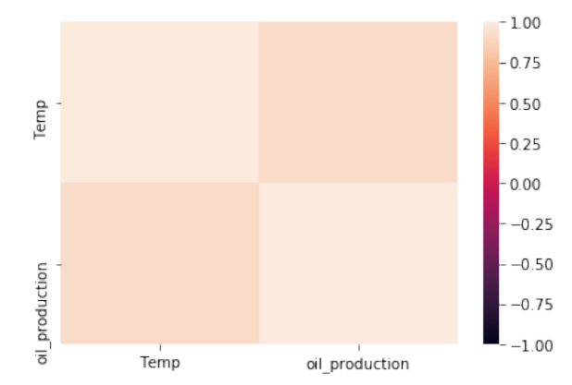
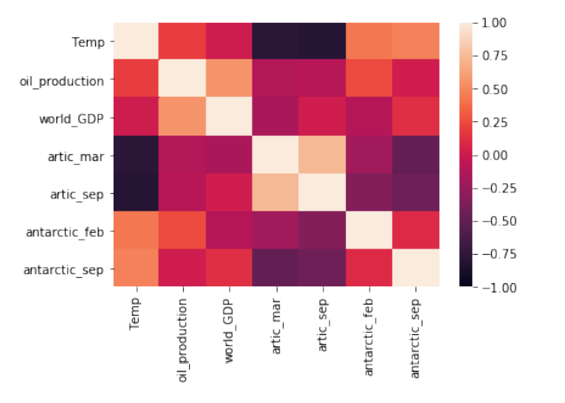
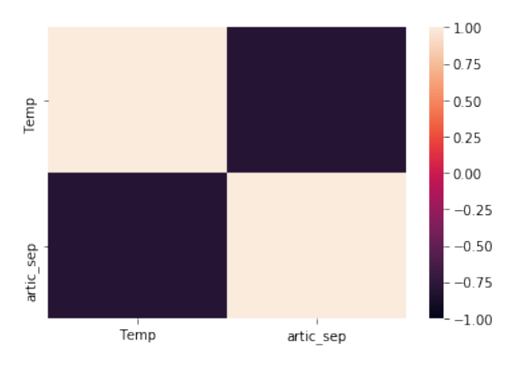
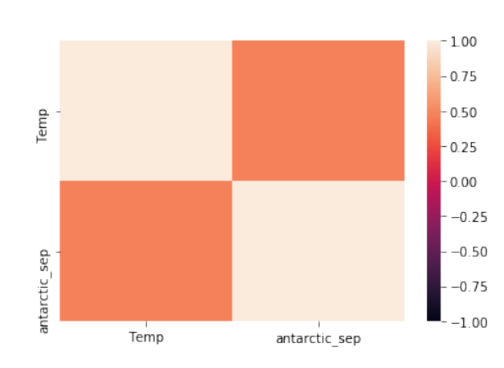
Data Analysis – Correlations

Slide 7
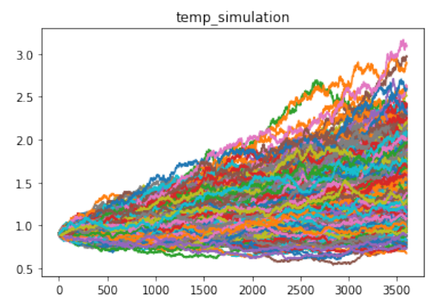
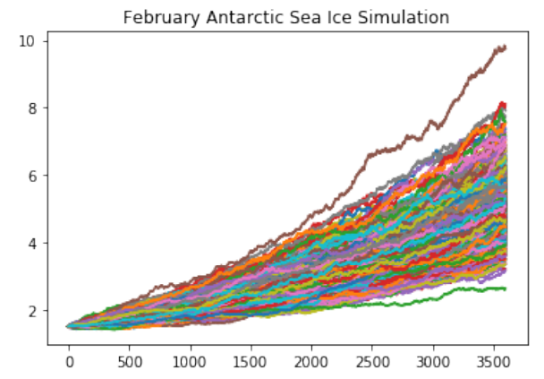
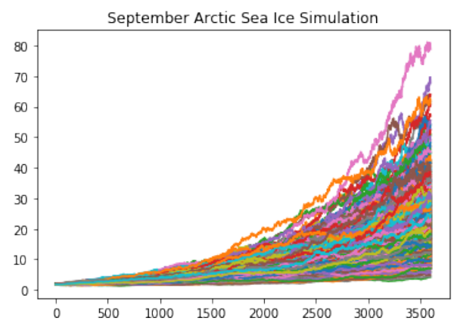
Data Analysis – Monte Carlo Simulations

Slide 8
Analysis for Discussion
Key Findings:
Correlation exists between world temperature and oil production.
No correlation between arctic sea ice melt and crude oil production.
Slight correlation between Antarctic sea ice melt and crude oil production.
Estimated 2-degree Celsius temperature variance in the next 10 years, per Monte Carlo simulation.
Potential accelerated sea ice melt over the next 10 years, per Monte Carlo simulations.
Conclusions:
Global warming is negatively impacting arctic and Antarctic sea ice
Increased oil production results in increased global temperature

Slide 9
Data Cleanup & Exploration
Insights:
Sea ice data was more applicable than glacier data, which was originally used.
Limited date range based on data availability.
GDP grouped by region rather than country specific.
Problems:
Incomplete data sets,
Reading in certain file types
Generating accurate Panel dashboards.
Jupyter Notebook Review

Slide 10
Additional Thoughts & Questions
More to Consider:
Could a correlation between greenhouse gas emission and GDP be identified?
Is there a correlation between oil price and production?
How do crude oil ETFs impact crude oil production?
Determine temperature change lag period.
Identify exact temperature differences and detailed climate data in Arctic and Antarctic locations .
What is the impact of global warming on marine life?
How much does meat processing and consumption impact global warming?
What is the impact of inflation on global warming?

Slide 11

Questions?

